Slide 1
Steganography
By:
Krishan Bhadana
Naweel Anwer
Under the guidance of-
Ms Meenakshi Moza

Slide 2
Content
What is Steganography?
Its Relation to Cryptography
Steganography for Network Security
Types of Steganography
Working
Future of Steganography

Slide 3
What is Steganography?
The word steganography comes from the Greek steganos , meaning covered or secret, and graphy , meaning writing or drawing. Therefore, steganography literally means covered writing.
Steganography simply takes one piece of information and hide it in another file,it could be(images,audio file,text)

Slide 4
Steganography & Cryptography
Steganography and Cryptography are closely related
They both are used for security
The difference is in their goals...
Cryptography: although encypted and unreadable, the existence of data is not hidden
Steganography: no knowledge of the existence of the data
Steganography and Cryptography can be used together to produce better protection

Slide 5
Steganography for Network Security
Confidentiality: any unauthorized person does not know that sensitive data exists
Survivability: verifying that the data does not get destroyed in the transmission
No detection: cannot be easily found out that the data is hidden in a given file
Visibility: people cannot see any visible changes to the file in which the data is hidden

Slide 6
Types of Steganography
Hiding a Message inside Text
Hiding a Message inside Audio and Video Files
Hiding a Message inside Images
Most popular technique

Slide 7
Hiding a Message inside Text
Partially effective
randoM capitalosis is a rarE disEase ofTen
contrAcTed by careless inTernet users. tHis sad
illnEss causes the aFfected peRsON To randomly
capitalize letters in a bOdy oF texT. please
do not confuse this disease witH a blatant
attEmpt aT steganogRAPhy.
Reveals: MEET AT THE FRONT OF THE TRAP

Slide 8
Hiding a Message inside Images
Steps - 1
Converting each alphabet to corresponding ASCII code

Slide 9
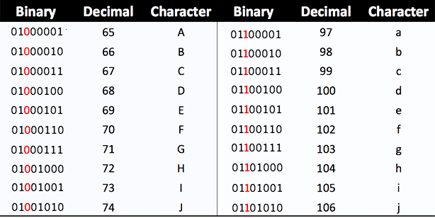

Slide 10
Hiding a Message inside Images
Steps - 2
Replacing the B in the RGB of each pixel of image by the ASCII code of each alphabet

Slide 11
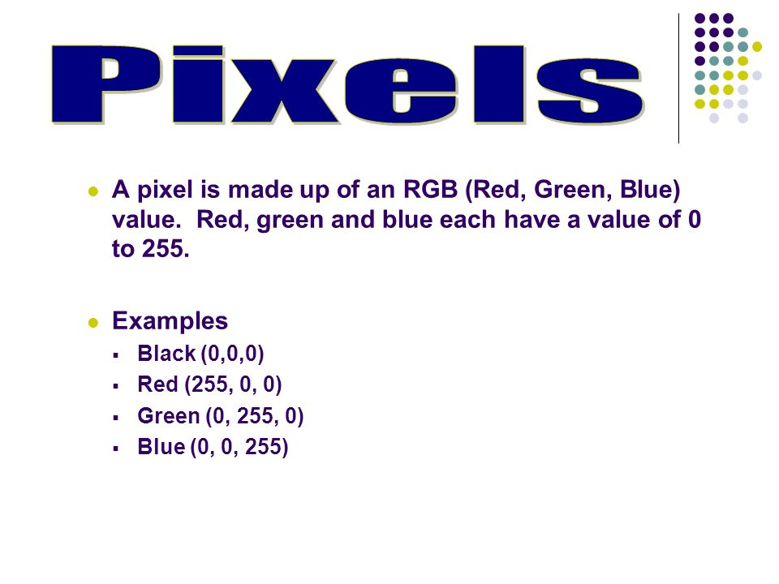


Slide 12
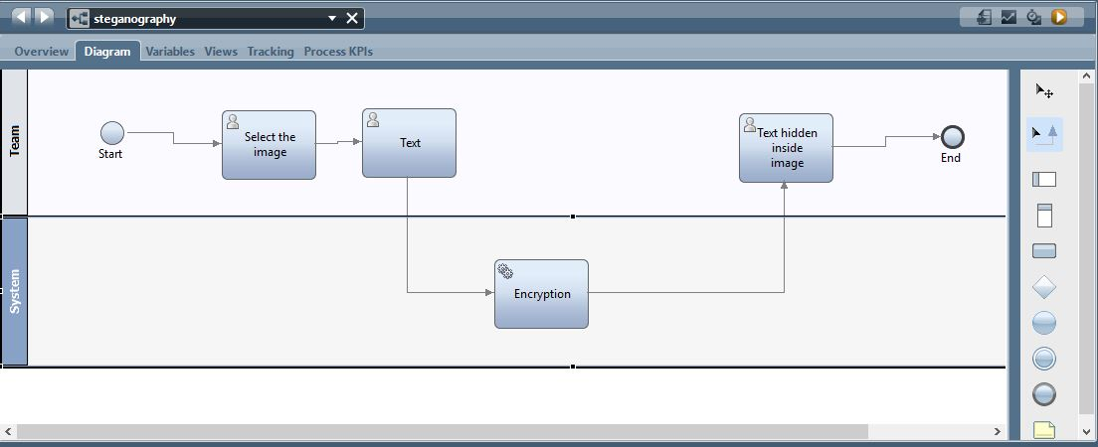
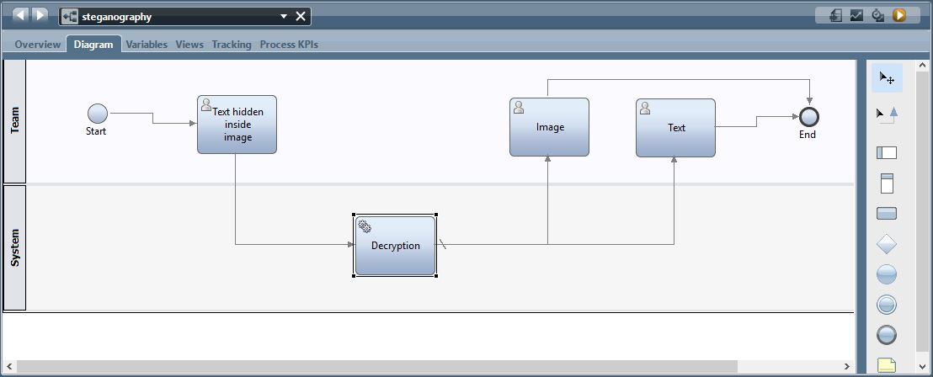

Slide 13
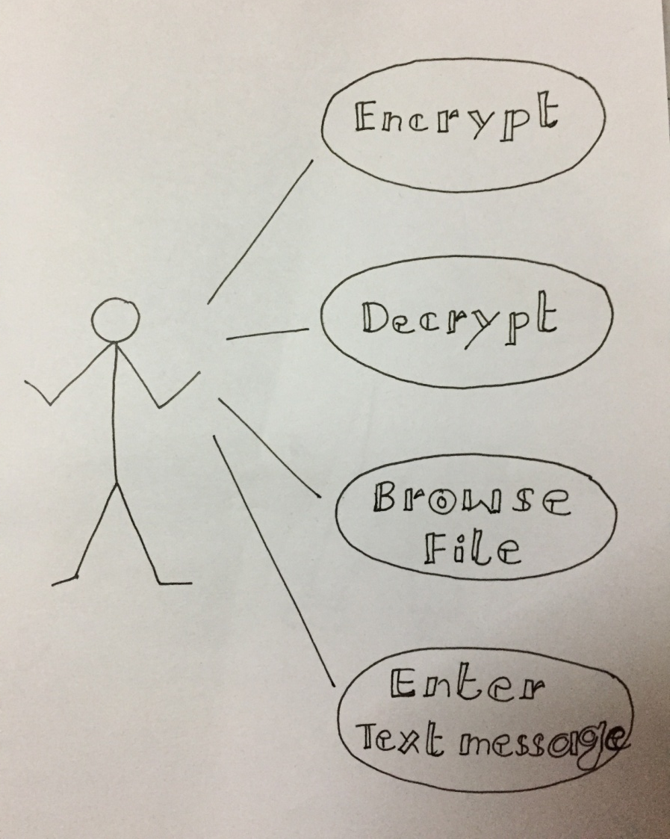

Slide 14
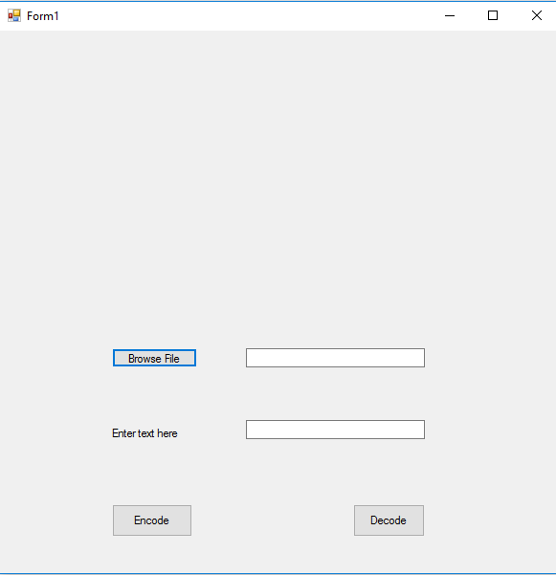

Slide 15
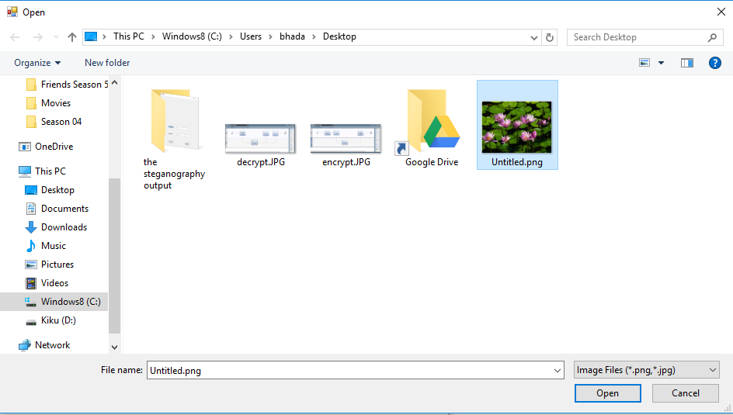

Slide 16
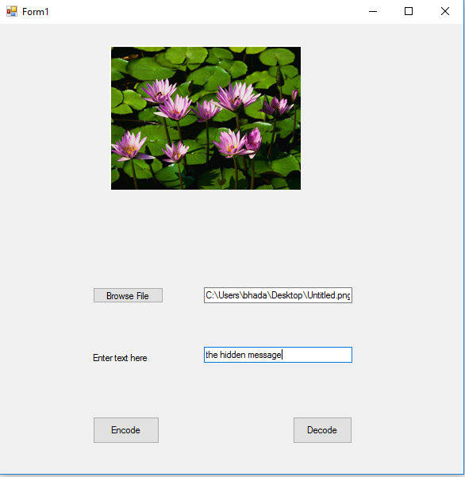

Slide 17


Slide 19


Slide 20
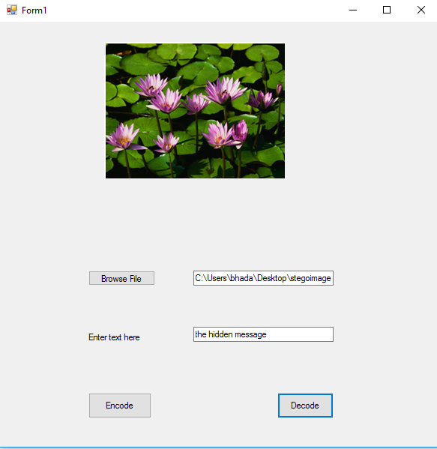

Slide 21
Future of Steganography
Might become limited under laws - governments claimed that criminals use steganography to communicate
The most important use of steganographic techniques will probably lie in the field of digital Security
...Thank You

